Slide 1
Used Cars Price Analysis
By Abhinav Davu

Slide 2
Agenda
Introduction
Objectives
Methodology
Data Collection
Data Cleaning
Data Visualization
Dashboard
Key Insights
Challenges
Conclusion

Slide 3
Introduction
The Indian used-car market is expanding rapidly, offering consumers affordable, quality vehicles across multiple cities and price points—creating a vibrant marketplace with diverse buyer and seller opportunities.
Online platforms like Droom aggregate extensive listing data across critical attributes (Brand, Fuel Type, Transmission, Year, Price, Kilometres Driven, Location), providing rich insights into market behaviour.
Used-car prices on Droom vary significantly across brands, locations, and vehicle conditions, driven by interconnected factors such as age, usage intensity, and regional demand—requiring structured data analysis to uncover transparent pricing patterns.

Slide 4
Objective
Goal: To understand and analyze the factors influencing used car prices to identify best-value vehicles.
Key Problems to Address: Analyzing car price variation across different brands. Identifying best cars with good quality at a lower price.
Data Source: Web scraped data from a reputed used car selling platform like Droom,Carwale.
To draw insights and conclusions that help users make data-driven decisions when buying used cars.

Slide 5
Methodology
Data Collection
Data Cleaning
Data Visualization

Slide 6
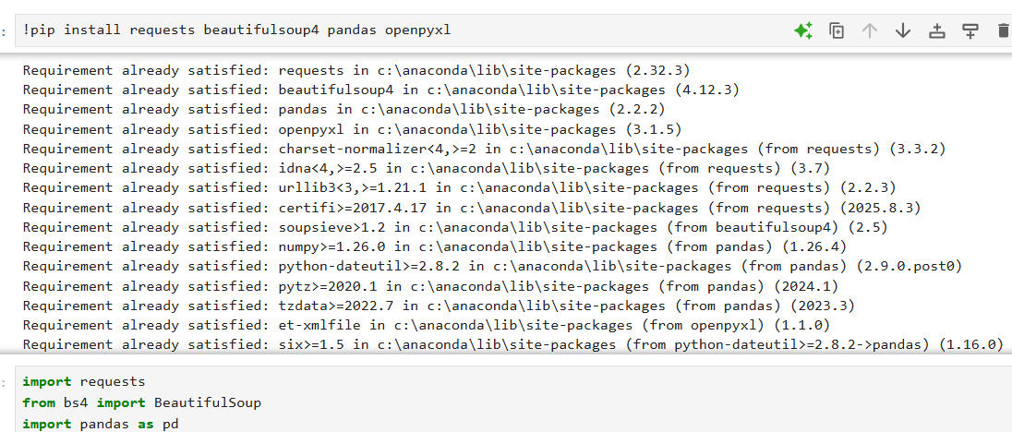
Data Collection
Web Scraping:
Objective: Gather comprehensive, structured data on used cars via web scraping targeting listings on Droom.in Tools Used:
Python Libraries: requests (send HTTP requests and fetch web pages), BeautifulSoup (parse HTML and extract structured data), pandas (organize and store extracted data in Excel format)
IDE/Environment: Jupyter Notebook.

Slide 7
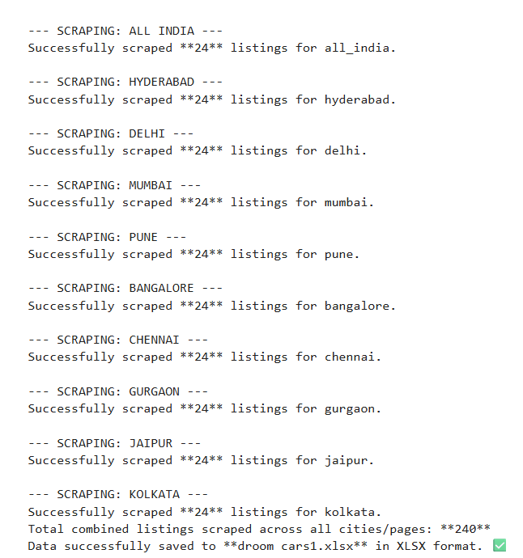
Data Collection
Comprehensive data set covering major Indian cities including Mumbai, Delhi, Bangalore, Chennai, Hyderabad, Pune and kolkata.
The automated scraper in this project was designed to visit up to 50 result pages for every selected Droom city URL, ensuring broad marketplace coverage and a statistically robust sample of used‑car listings for analysis.

Slide 8
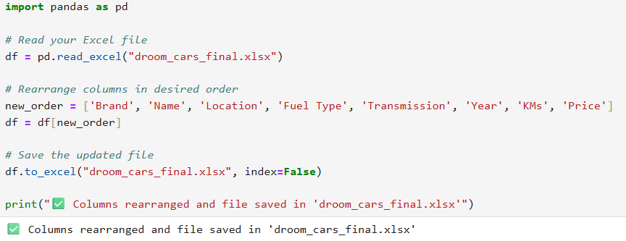
Data Cleaning
Extracted Brand (first word of the car name) and Year from the Name field into separate columns for easier analysis.
Removed rows with missing critical values and dropped duplicate listings to improve data reliability.
Standardized the Price field by stripping the rupee symbol and commas and converting it into a numeric Lakhs column.
Converted the KMs field from text to a clean numeric column (KMs_Numeric) so that distance driven can be aggregated and plotted.

Slide 9
Data Visualization
Tool Used:
Power BI Dashboards
Clear insights into factors affecting used car prices.
Identification of best-value car brands and price trends across cities

Slide 10
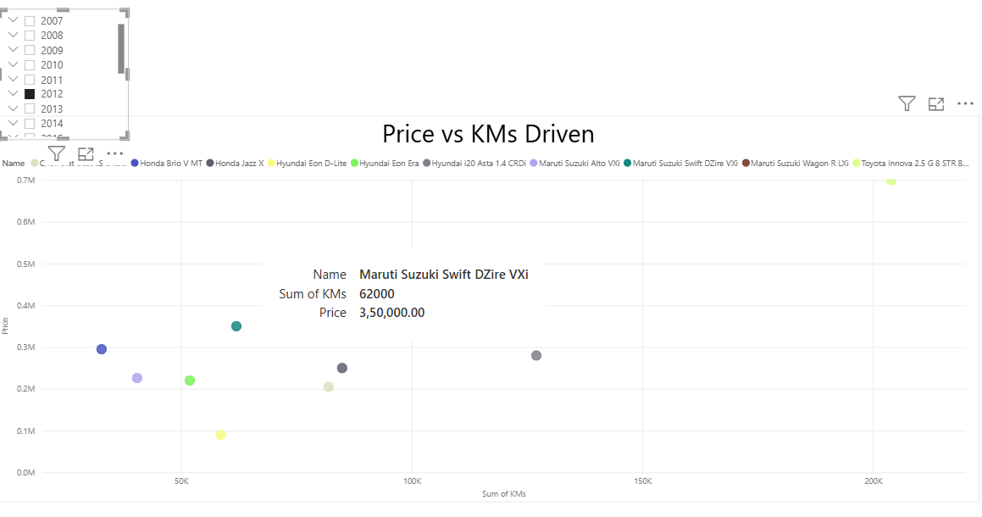
Compared Price vs KM’s avg year wise with brand.
The scatter plot reveals a clear negative correlation between kilometres driven and car price—vehicles with higher mileage tend to have lower resale prices, reflecting depreciation due to increased usage.

Slide 11
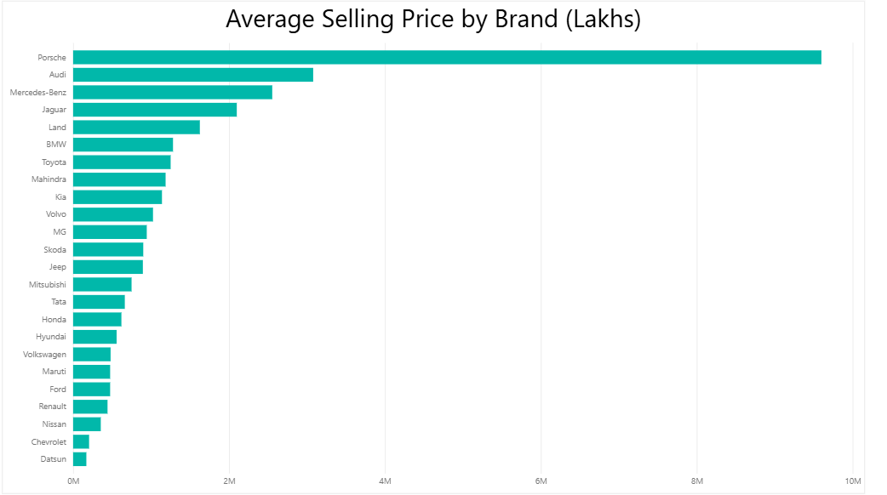

Slide 12
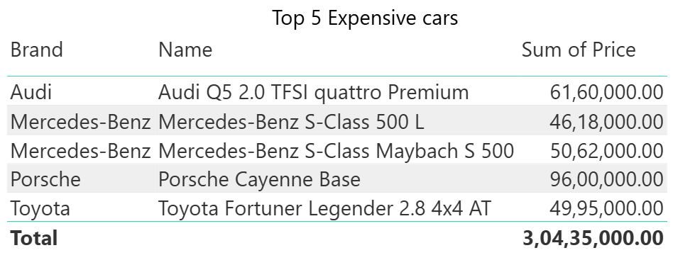

Slide 13
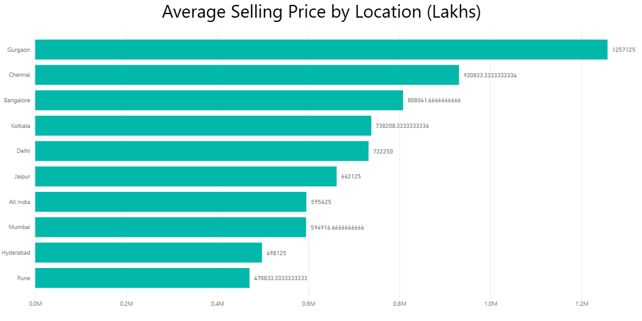

Slide 14
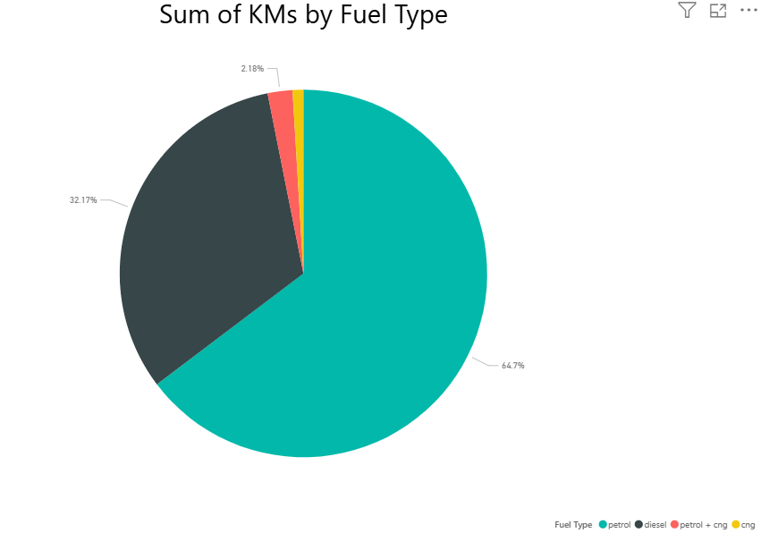

Slide 15
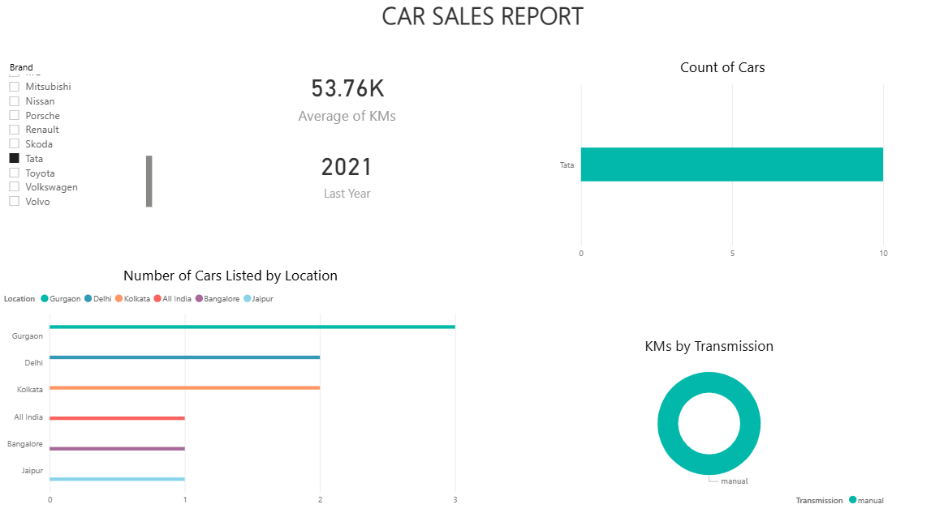

Slide 16
Key Insights
Petrol cars account for 64% of total kilometers driven, indicating higher usage compared to diesel (32%) and CNG (2%). Petrol vehicles show greater mileage accumulation, suggesting more frequent urban and short-distance travel.
Luxury brands lead pricing:Porsche Cayenne – ₹95 Lakhs, followed by Audi Q5 2.0 TFSI quattro Premium – ₹61.6 Lakhs, Toyota Fortuner Legender 2.8 4x4 AT – ₹49.95 Lakhs, Mercedes-Benz S-Class Maybach S 500 – ₹50.62 Lakhs and Mercedes-Benz S-Class 500 L – ₹46.18 Lakhs

Slide 17
Conclusion
The used car market exhibits predictable patterns influenced by transmission type, fuel efficiency, geographic location, and vehicle age. Data-driven insights enable stakeholders to make informed decisions aligned with market dynamics and consumer preferences.

Slide 18
THANK YOU

